Slide 1
BIFX 503: Biostatistics in R
Instructor: Jennifer Schroeder, Ph.D.
Wednesdays, 5:30-8:00pm
Hodson Technology Center, Room 237
Fall 2021

Slide 2
Content: Principal Components and Cluster Analysis
Principal Components Analysis (PCA)
Cluster Analysis
Hierarchical
K Means
Density-based clustering algorithm
DBSCAN

Slide 3
Data Mining
Impose order or structure on a dataset
Discover and extract patterns in data
Two common techniques:
Principal components analysis finds groups of variables that are similar to each other
Cluster analysis finds groups of observations that are similar to each other

Slide 4
Principal Components Analysis
Primary uses:
Understand the data structure (how measures relate to one another)
Reduce a complex dataset to a more manageable size while retaining as much of the original information as possible

Slide 5
Principal Components Analysis (PCA)
PCA decomposes the original data into a set of linear variates
Finds the linear components that exist within the data, and how each variable contributes to the components

Slide 6
Applications of PCA
Exploratory analysis
Understand data structure
Data dimension reduction
Helpful for very “wide” datasets

Slide 7
Goal of PCA
Describe the variation in a set of correlated variables x₁, x₂, …, x_{n} in terms of a new set of uncorrelated variables y₁, y₂, …, y_{n}
Each y variable is a linear combination of the x variables
The y variables vary in how much of the variation of the x’s they account for
The first one accounts for most, followed by the second, etc…

Slide 8
Mathematical Representation
The y variables are components, b’s are loadings
Each variable’s loading is the degree of association between that variable and the component
The loading squared is a measure of the importance of that variable to a component
Y_{i} = b₁X_{1i} + b₂X_{2i} + … + b_{n}X_{ni}

Slide 9
Component Scores
A component score can be calculated using the observed values of the x’s and the loadings
The component scores take the place of the original variables in analysis
Y_{i} = b₁X_{1i} + b₂X_{2i} + … + b_{n}X_{ni}

Slide 10
PCA for Dimension Reduction
Since most of the variability of the x’s is explained by the first few y’s, the component scores from the first few y’s can be substituted for the x’s
Say you have 100 variables and do PCA
The first 3 components account for most of the variance
Most of the variability in 100 variables is captured in 3 new variables

Slide 11
How Many Components to Use?
Theoretically, it is possible to have as many components as there are variables
Doesn’t make sense to use them all
Objective is simplification!
Criteria for determining which to use
Kaiser (1960) recommended retaining all components with eigenvalues > 1
Cattell (1966) recommended using a scree plot

Slide 12
Eigenvalues
Each component has a corresponding eigenvalue
The eigenvalue represents the amount of variation explained by the component
Eigenvalue of 1 is considered “substantial” amount of variation
This is subjective …

Slide 13
Scree Plot
A scree plot is a plot of Variance (Y axis) vs. Components (x axis)
Variances are plotted in descending order
Sharp descent as components become less informative/important
Inflection point where curve flattens out
Use this a cutoff for retaining components

Slide 14
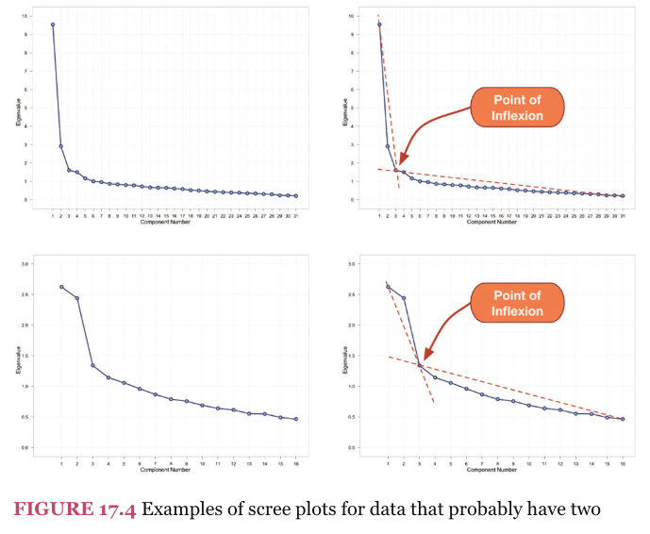
Scree Plot

Slide 15
Correlation
The starting point for PCA is a correlation matrix
Look for clusters of variables that are highly correlated with each other
Evidence that they are measuring similar things

Slide 16
Conditions for Correlation
Both variables must be quantitative and normally distributed
The relationship between them must be linear
There should be no strong outliers
Outliers can affect (bias) the correlation
No missing data

Slide 17
Correlations Between Variables
Correlation matrix should have several “sizable” correlations
If all correlations are low (<0.3) it doesn’t make sense to do PCA
This is subjective …..

Slide 18
PCA: Requirements
Continuous, quantitative variables that are measured on the same scale
Variables can be standardized before performing PCA if on different scales
A fairly large dataset (at least 200 observations)
No missing measurements
Ideally, variables are normally distributed with no extreme outliers and many sizable correlations

Slide 19
PCA: Method
Standardize the variables to be analyzed
Calculate the correlation matrix using the scaled variables
The variance in the correlation matrix is used to calculate eigenvalues, which is used to extract the components
Component scores are calculated from the loadings

Slide 20
PCA in R: Preliminaries
Standardize variables
scale(variables)
Can also do with dplyr mutate() or transmute()
Transforms them to have mean=0, variance=1
Calculate the correlation matrix using the standardized variables
cor(scaled.variables)
Visualize associations using scatterplot matrix and/or heat map
pairs(scaled.variables, lower.panel=NULL, cex.labels=2, pch=19, cex=1.2)
heatmap(cormat, symm=TRUE, revC=TRUE, margins=c(10,10))
Where “cormat” is a stored correlation matrix

Slide 21
PCA in R: Functions
Perform factor analysis, two options:
princomp(): eigenanalysis of covariance or correlation matrix
prcomp(): singular value decomposition of data matrix

Slide 22
PCA in R: Output
summary()
Variation explained by each component
princomp()
Loadings: $loadings
Scores: $scores
prcomp()
Loadings: $rotation
Scores: $x
Scree plot
plot(object, type=“lines”)
Where object is PCA results returned by princomp() or princomp()
pca <- princomp(scaled.data)
plot(pca, type=“lines”)

Slide 23
PCA Example #1: Heptathlon
Olympic Heptathlon data
heptathlon from package HSAUR3
25 observations (competitors)
8 variables (7 events plus total score)

Slide 24
Heptathlon Example
First look at data distributions
No missing values
Variables are reasonably normally distributed
Data manipulations
Reverse-score some events so that large values are a ‘good’ score
hurdles, run200m, run800m
Standardize the variables so they are all on the same scale

Slide 25
Heptathlon Example
Calculate correlation matrix – do they seem correlated?
Most correlations are fairly high
Javelin is not correlated with other variables
Visualize the associations:
Scatterplot matrix
Heat map
Outlier (PNG) is removed and correlations & graphics redone

Slide 26
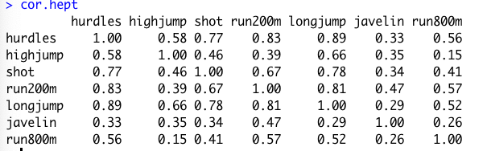
Heptathlon Example
Removal of outlier increased correlations for javelin

Slide 27
Heptathlon Example
PCA using prcomp()
pca1 <- prcomp(scaled.hept2, scale=TRUE)
summary(pca1)
To see variance accounted for by each component
pca1$rotation
To see how each variable “loads” on each component
Higher loading = stronger association
plot(pca1, type=“lines”)
To see scree plot
pca1$x
To see component scores for each competitor

Slide 28
Heptathlon Example
PCA using princomp()
pca2 <- princomp(scaled.hept2, cor=TRUE)
summary(pca2)
To see variance accounted for by each component
pca2$loadings
To see how each variable “loads” on each component
plot(pca2, type=“lines”)
To see scree plot
pca2$scores
To see component scores for each competitor

Slide 29
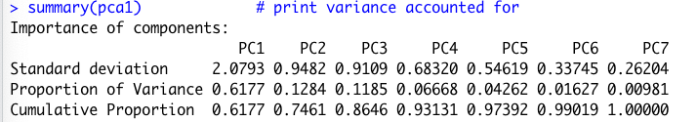
Heptathlon Example
First 3 components account for 86% of variance
Scree plot drops after this
Retain 3 components only?

Slide 30
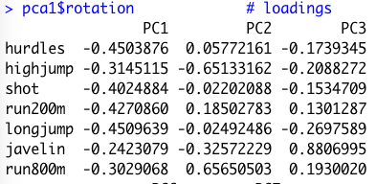
Heptathlon Example
Here are loadings for first 3 components
Hurdles, shot, run200m, longjump load highest on PC1
Highjump, run800m load highest on PC2
Javelin loads highest on PC3

Slide 31
Heptathlon Example
To limit the number of components retained
Function principal() in psych package
pca <- principal(data, nfactors=3)
Only three components extracted
End result: Use component scores in analysis instead of original variables
Dimensionality reduced from 7 variables to 3

Slide 32
PCA Example #2: Iris
Use the iris dataset, which consists of data collected on three species of iris
Sepal length, sepal width, petal length, petal width, and species
Ignoring species, perform a PCA on these data
Scale the variables
Calculate the correlation matrix
Look for “clusters” of high correlations
Perform PCA
How many components?

Slide 33
Iris Example
Correlation matrix
cor(scaled.iris) Sepal.Length Sepal.Width Petal.Length Petal.Width
Sepal.Length 1.0000000 -0.1175698 0.8717538 0.8179411
Sepal.Width -0.1175698 1.0000000 -0.4284401 -0.3661259
Petal.Length 0.8717538 -0.4284401 1.0000000 0.9628654
Petal.Width 0.8179411 -0.3661259 0.9628654 1.0000000
Most variables highly correlated
Sepal width not well correlated with other variables

Slide 34
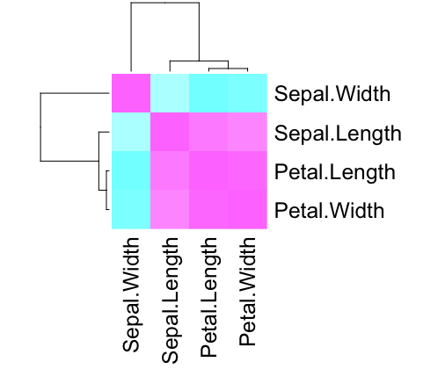
Iris Example
Heat map of correlations

Slide 35
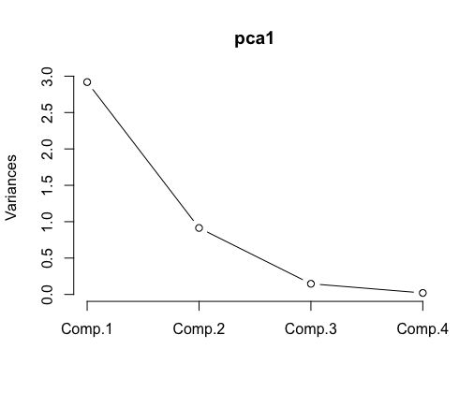
Iris Example
Scree plot

Slide 36
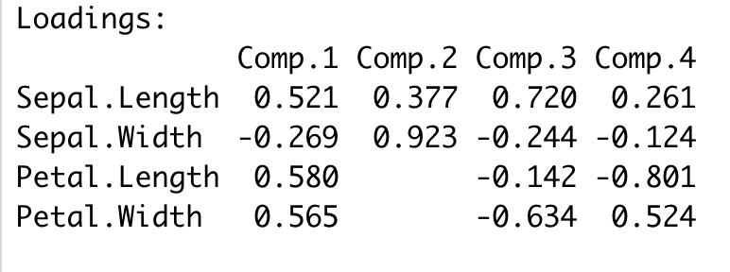
Iris Example
Importance of components:
Comp.1 Comp.2 Comp.3 Comp.4
Standard deviation 1.7083611 0.9560494 0.38308860 0.143926497
Proportion of Variance 0.7296245 0.2285076 0.03668922 0.005178709
Cumulative Proportion 0.7296245 0.9581321 0.99482129 1.000000000
Two components account for >95% of variance

Slide 37
Cluster Analysis

Slide 38
Cluster Analysis: Questions
How do we define close?
How do we group things?
How can we visualize the groupings?
How do we interpret the groupings?

Slide 39
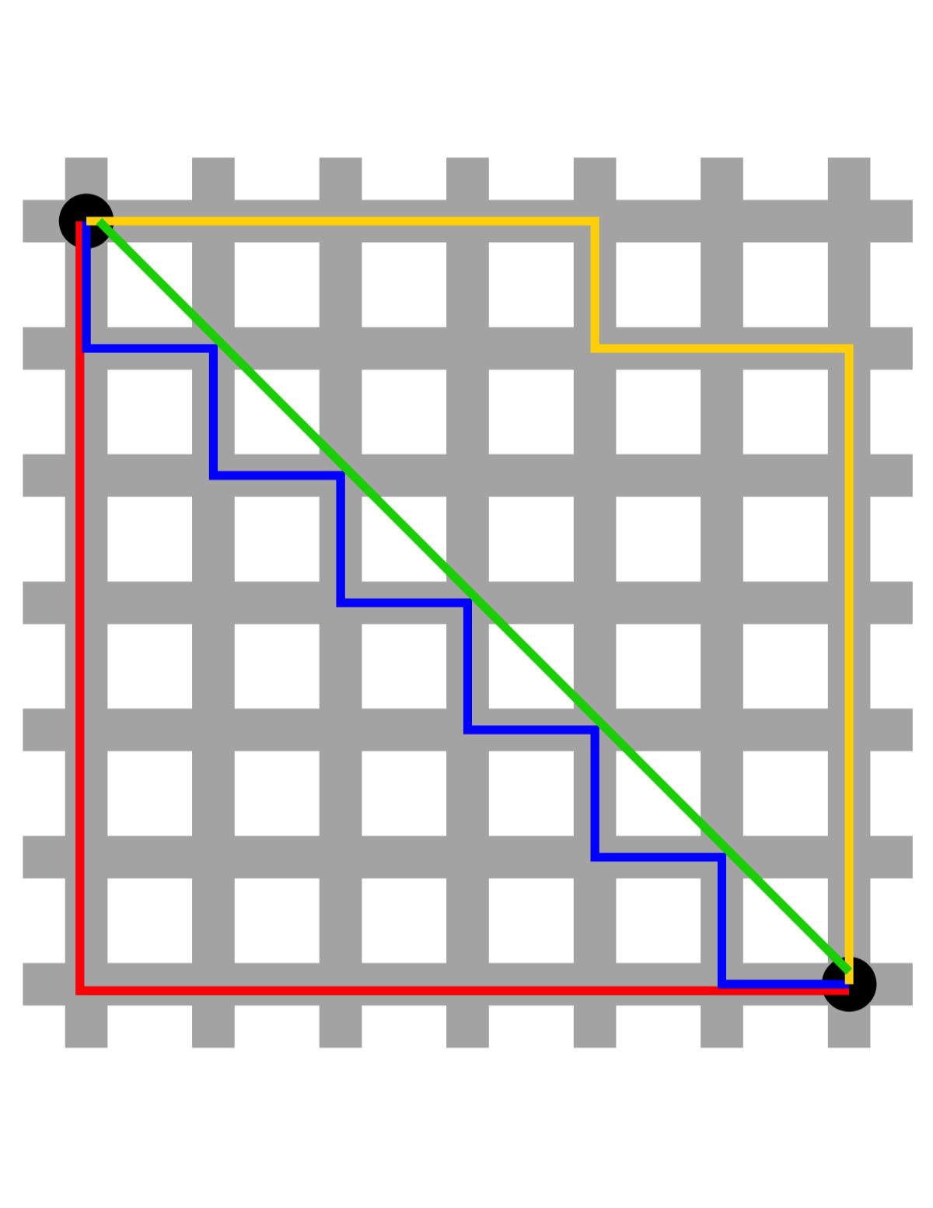
How To Define Close?
Euclidean distance (green)
Manhattan distance (blue)
Image from “Taxicab geometry” (Wikipedia)

Slide 40
How Do We Group Things?
Hierarchical clustering (a.k.a. agglomerative)
Bottom-up approach in that the number of clusters not specified a priori
Start with individual data points and put the most similar ones together into clusters, then similar clusters get combined into bigger clusters and so on
K-means clustering
Number of clusters (k) is specified a priori
Start with the centroid of each cluster, assign data points to the closest centroid; re-calculate centroid positions and repeat

Slide 41
Hierarchical Clustering

Slide 42
Hierarchical Clustering
Find two “closest” points in your dataset
Merge them, and call them a “point”
Complete merging: distance between clusters is the distance between the two points that are furthest apart
Average merging: distance between clusters is the distance between the average coordinates in each group
Using your new dataset with this new “point” instead of the two original data points, repeat

Slide 43
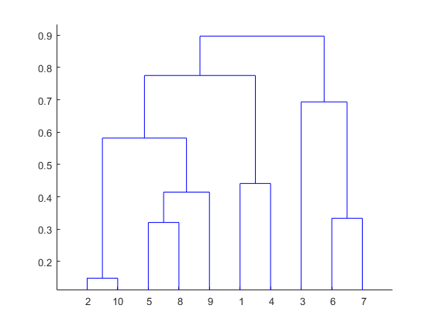
Dendrogram
The end result of hierarchical clustering is a dendrogram, or tree map showing how the data cluster together

Slide 44
Interpreting Dendrograms
Focus on the height at which any two objects are joined together
More similar objects are joined at lower heights on graph
On previous slide, objects 2 and 10 are most similar

Slide 45
How Many Clusters?
Deciding how many clusters best represent the data is a very subjective choice
Based on the pattern in the dendrogram, choose a reasonable number of clusters

Slide 46
Allocating Observations to Clusters
Once you have chosen the number of clusters, you draw a horizontal line through the dendrogram
“cutting the tree”
number of branches cut = number of clusters

Slide 47
Hierarchical Clustering in R
Calculate distance matrix using dist()
Euclidean distance is default
Six possible methods
euclidean, maximum, manhattan, canberra, binary, minkowski
mydist <- dist(dataFrame)
For Euclidean distance
mydist <- dist(dataFrame, method=“manhattan”)
For manhattan distance

Slide 48
Hierarchical Clustering in R
Perform cluster analysis using hclust()
Complete method is default
Eight possible methods
ward.D, ward.D2, single, complete, average, mcquitty, median, centroid
myclust <- hclust(mydist)
For complete method
myclust <- hclust(mydist, method=“average”)
For average method

Slide 49
Hierarchical Clustering in R
Plot dendrogram using plot()
plot(myclust)
Cut tree into desired number of clusters (k=) using cutree(), delineated with red rectangles
groups <- cutree(myclust, k=3)
rect.hclust(myclust, k=3, border=“red”)

Slide 50
Example #1: Simulated Data
Generate simulated data (three clusters):
Scatter plot, to visualize clusters
set.seed(1234)
x <- rnorm(12, rep(1:3, each = 4), 0.2)
y <- rnorm(12, rep(c(1, 2, 1), each = 4), 0.2)
dataFrame <- data.frame(x=x, y=y)
plot(x, y, col = "blue", pch = 19, cex = 2)
text(x + 0.05, y + 0.05, labels = as.character(1:12))

Slide 51
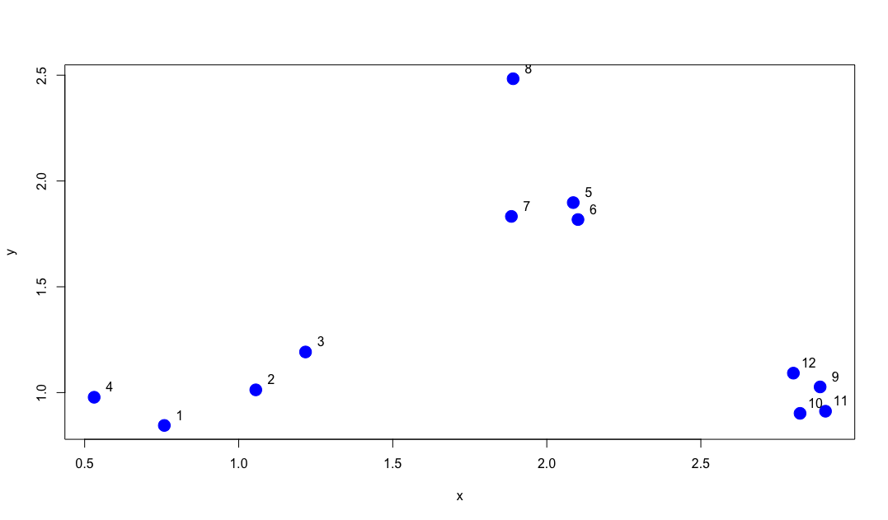
Example #1: Simulated Data

Slide 52
Example #1: Simulated Data
Calculate distance matrix using dist()
mydist <- dist(dataFrame)
Perform cluster analysis using hclust()
myclust <- hclust(mydist, method=“average”)

Slide 53
Example #1: Simulated Data
Plot dendrogram using plot()
plot(myclust)
Cut tree into three clusters using cutree(), delineated with red rectangles
groups <- cutree(myclust, k=3)
rect.hclust(myclust, k=3, border=“red”)

Slide 54
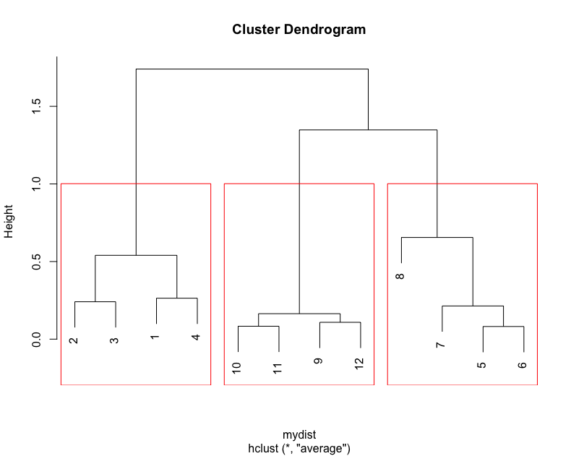
Example #1: Simulated Data

Slide 55
Example #2: Iris Data
Iris data (ignoring species)
Make scatterplots to visualize the data
Perform hierarchical cluster analysis on the data
How many clusters are apparent?

Slide 56
Example #2: Iris Data
Scatterplot matrix using pairs()
sp.cols <- character(nrow(iris))
sp.cols <- "black”
sp.cols[iris$Species == "setosa"] <- "cornflowerblue”
sp.cols[iris$Species == "versicolor"] <- "mediumseagreen”
sp.cols[iris$Species == "virginica"] <- "orchid”
species_labels <- iris[,5]
pairs(iris.q, col=sp.cols, lower.panel=NULL, cex.labels=2, pch=19, cex=1.2)
par(xpd = TRUE)
legend(x = 0.05, y = 0.4, cex=2, legend=as.character(levels(species_labels)), fill=unique(sp.cols))
par(xpd = NA)

Slide 57
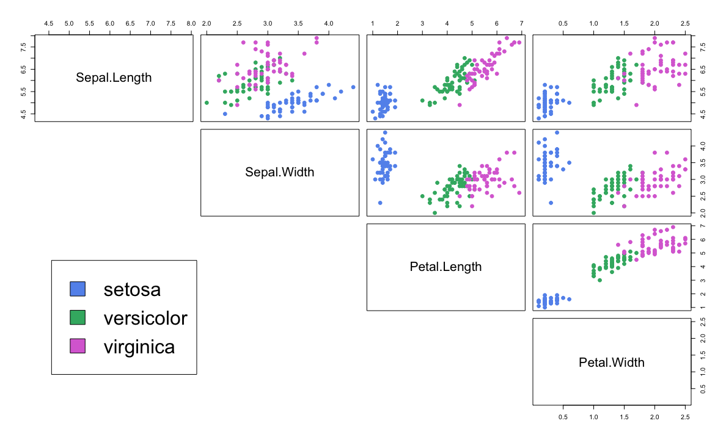
Example #2: Iris Data

Slide 58
Example #2: Iris Data
Calculate distance matrix
iris.dist <- dist(iris.q)
iris.dist2 <- dist(iris.q, method=“manhattan”)

Slide 59
Example #2: Iris Data
Perform cluster analysis
iris.clust <- hclust(iris.dist)
iris.clust2 <- hclust(iris.dist, method=“average”)

Slide 60
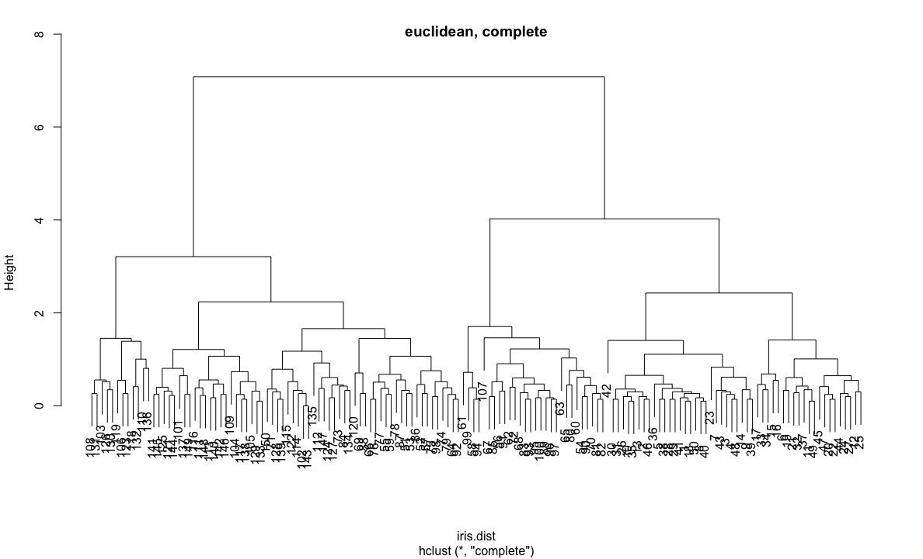
Example #2: Iris Data
Plot dendrogram
plot(iris.clust)

Slide 61
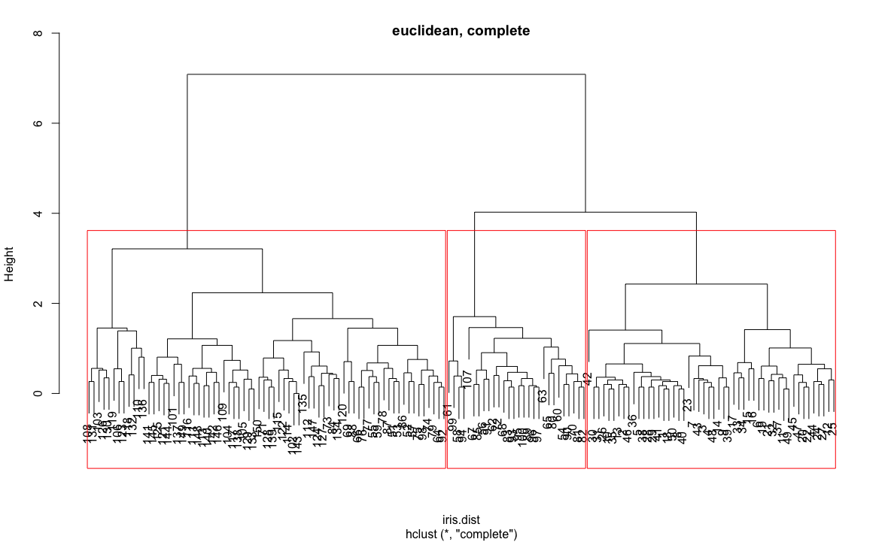
Example #2: Iris Data
Cut dendrogram into desired number of clusters
iris.groups <- cutree(iris.clust, k=3)
rect.hclust <- iris.clust(k=3, border=“red”)

Slide 62
Example #2: Iris Data
Repeat, varying methods used for distance matrix and clustering algorithm
Manhattan vs. Euclidean distance
Average vs. Complete clustering
How consistent are the results?

Slide 63
Class Exercise
Arrest data USArrests
Arrests per 100,000 citizens for each state
Perform hierarchical clustering
Compute distance matrix
Produce dendrogram
How many clusters are evident?
Repeat, using two different methods to calculate the distance matrix, and two different clustering algorithms
How consistent are the results?

Slide 64
K Means Clustering

Slide 65
K-Means Clustering
Fix the number of clusters (k) at an integer ≥2
Calculate the centroids of each cluster
Initially, this is a randomly selected k data points
Assign each data point to its closest centroid
Re-calculate centroid positions based on cluster membership
Repeat until the cluster centroids stabilize and stop moving with each iteration
End result:
Final estimate of cluster centroids
Cluster membership of each data point

Slide 66
K-Means Clustering in R
Perform k means clustering using kmeans()
Specify number of clusters (centers=)
Four clustering algorithms
Hartigan-Wong algorithm is default
Others: Lloyd, Forgy, McQueen
mykmeans <- kmeans(dataFrame, centers = 3)

Slide 67
K-Means Clustering in R
Obtain cluster membership
mykmeans$cluster
Obtain coordinates of centers
mykmeans$centers
Add to scatter plot

Slide 68
Example #1: Simulated Data
Use same simulated data as in previous example

Slide 69
Example #1: Simulated Data
Perform k means clustering using kmeans()
mykmeans <- kmeans(dataFrame, centers = 3)
Obtain cluster membership
mykmeans$cluster
3 3 3 3 1 1 1 1 2 2 2 2
Obtain coordinates of centers
mykmeans$centers
x y
1 1.9906904 2.0078229
2 2.8534966 0.9831222
3 0.8904553 1.0068707

Slide 70
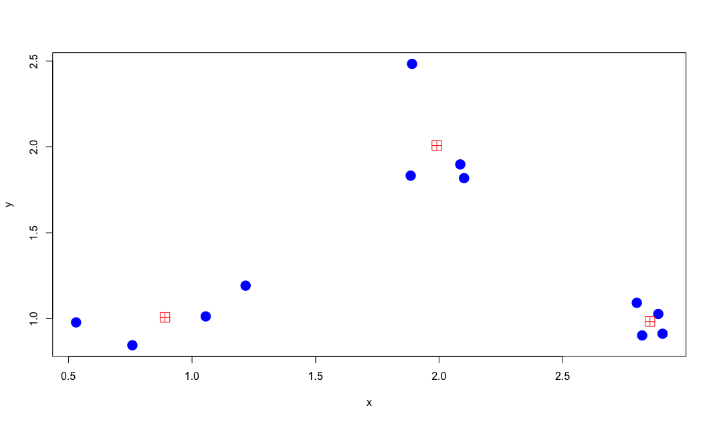
Example #1: Simulated Data
plot(x, y, col = "blue", pch = 19, cex = 2)
points(mykmeans$centers, col = "red", pch = 12, cex = 2)

Slide 71
Example #2: Iris Data
iris data
Perform K-means cluster analysis on the data
Three clusters (species)
Do the results agree with species assignment?

Slide 72
Example #2: Iris Data
iris.kmeans <- kmeans(iris.q, centers=3)
iris.clusters <- cbind(iris, iris.kmeans$cluster)
iris.clusters$Cluster <- iris.kmeans$cluster
table(iris.clusters$Species, iris.clusters$Cluster)
1 2 3
setosa 50 0 0
versicolor 0 48 2
virginica 0 14 36

Slide 73
Example #2: Iris Data
Setosa accurately classified – all in cluster 1
Versicolor all in cluster 2 with the exception of two plants
Virginica – most in cluster 3
1 2 3
setosa 50 0 0
versicolor 0 48 2
virginica 0 14 36

Slide 74
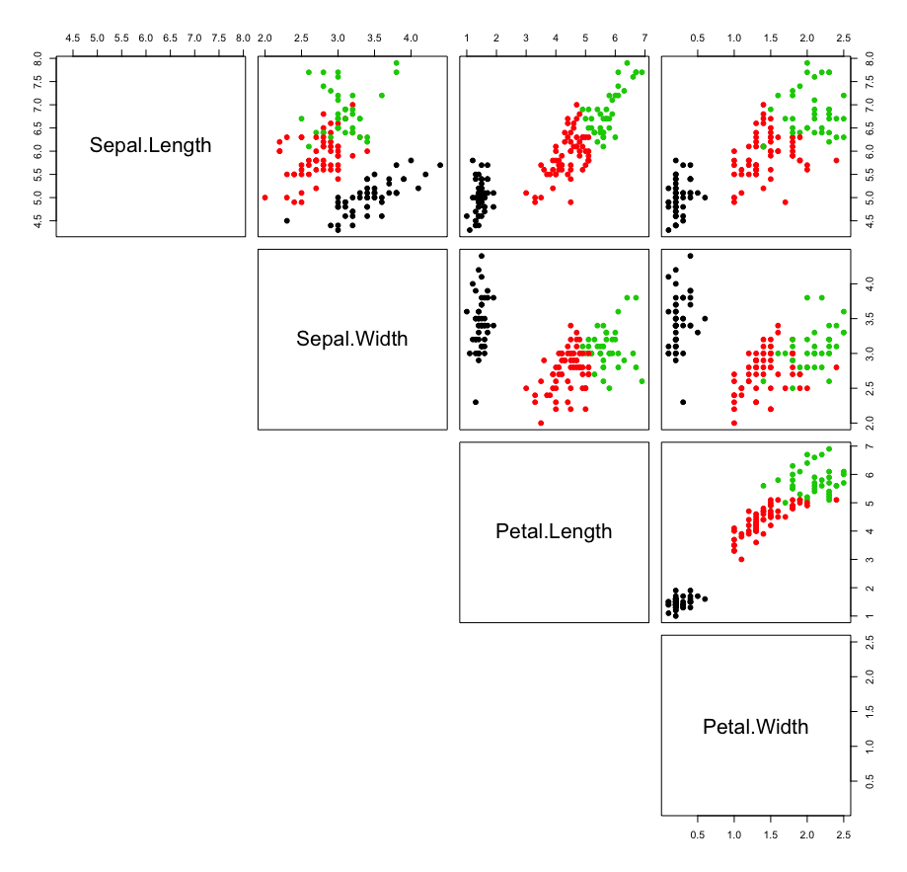
Example #2: Iris Data
pairs(iris.q, col=iris.kmeans$cluster, pch=19, lower.panel = NULL)
## 1=black 2=red 3=green

Slide 75
Class Exercise
Perform k means clustering of arrest data
USArrests
Choose number of clusters based on the results of your hierarchical analysis
Examine the cluster assignments
Which states are grouped together?
How do clusters differ in terms of the input variables?

Slide 76
Density-Based Cluster Analysis
Most popular: DBSCAN
Density Based Spatial Clustering of Applications with Noise
Groups together points that are closely packed
Outliers are points in low-density areas

Slide 77
Cluster Analysis: Conclusions
Used to classify members of the sample
Hierarchical clustering: exploratory
Primarily graphical
Understand data structure
K-Means
Must specify number of clusters up front
Result: group membership

Slide 78
DBSCAN Algorithm
Two input parameters:
ε (eps)
minPts: the minimum number of points to form a dense region
Find the points in the ε neighborhood of every point
Identify the core points with more than minPts neighbors
Find the connected components of core points
Assign each non-core point to a nearby cluster if the cluster is an ε neighbor, otherwise assign it to noise

Slide 79
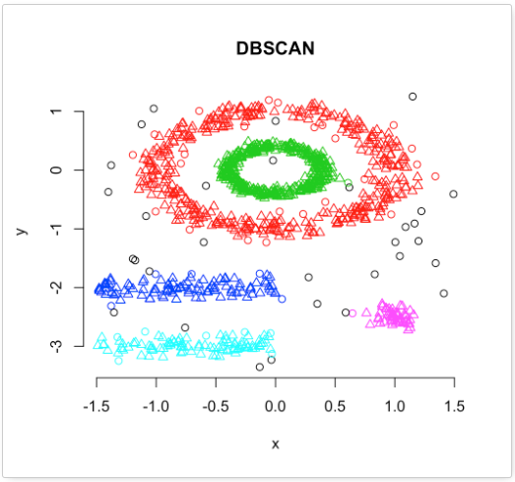

Slide 80
DBSCAN Advantages
No need to specify the number of clusters a priori
Can find non-linear clusters
Can find a cluster that is completely surrounded by another cluster
Available in R (package Dbscan)

